Slide 1
Collections Behavioral Scorecard Development for 123Retail
RAG Summer practice – Final Presentation

Slide 2
Project Goal and Client Summary
The objective of the independent project was to develop a collections scorecard using provided behavioral data as well as bureau score and bureau characteristics for each applicant. The behavior of customers who have defaulted was modeled using multivariate linear regression techniques. As a result a scorecard was produced to be used for building a custom collections strategy for the client.
Include client summary from the project spec here

Slide 3
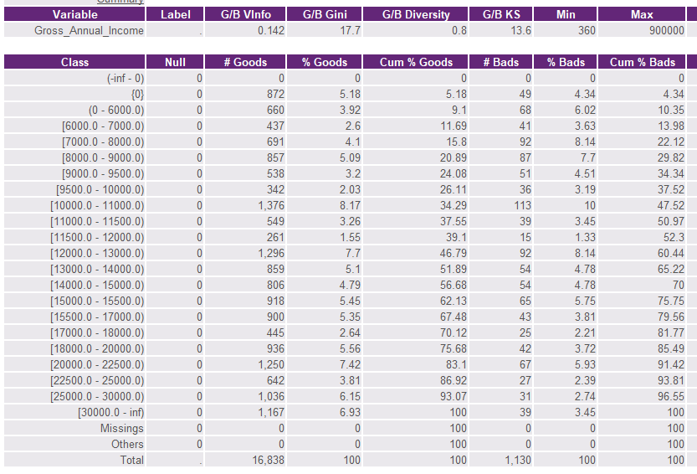
Fine Classing
Paste a screenshot of one variable of your choice.
Briefly explain why we do fine-classing.
List 3-5 important aspects of fine-classing, e.g.:
Create bands of ~3-5%
2
3
4
5

Slide 4
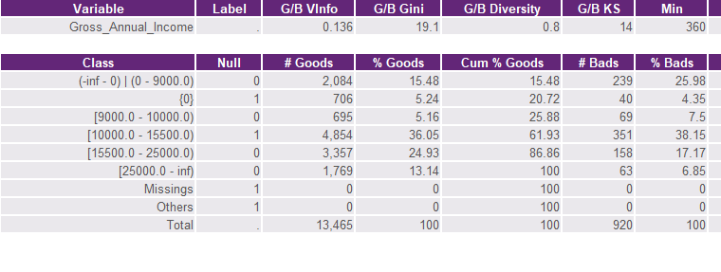
Coarse Classing
Paste a screenshot of one variable of your choice.
Briefly explain why we do coarse-classing.
List 3-5 important aspects of coarse-classing, e.g.:
Smooth G:B Index (Odds) trend on numeric variables
2
3
4
5

Slide 5
Known Good/Bad Model What modeling technique?
Goal of the KGB model?
Type of regression?
Subpopulation?
What stats/measures do we look at when running the model?

Slide 6
Summary of Results
Column1 | Example | Name | Name2 | Name3 | Name4
Number of Variables | 17
Gini Coefficient on Total | **
Gini Uplift | 43.5
Gini Coefficient on Development | **
Gini Coefficient on Validation | **
Model validates on the 9 measures at 5% significance | YES
Max % of population accummulated in a band | 5.65%
Nº of inversions in the SDR at 5% bands | 1

Slide 7
Summary of Results (cont’d)
Characteristics | Example | Name | Name2 | Name3 | Name4
Age_Of_Account | X
Ave_Current_Balance_L4_6P
Ave_Item_Value_L13P | X
Ave_Num_Items_Per_Order_L4_6P
Ave_Order_Value_L13P
Ave_Payment_Value_L13P
Ave_Payment_Value_L4_6P | X
Ave_Pmnt_Over_Bal_L13P_Perc | X
List your scorecard characteristics (maybe on two slides) and indicate which ones were common among group members.
Embed SC and SDR – in case there is interest to view and discuss.

Slide 8
Example Strategy
(Quickly present the strategy, recommendations and bad rate bands on the different risk grades – in this examples, the bad rate thresholds are: 0-10, 10-35, 35-65, 65-80, 80-100)

